Slide 1
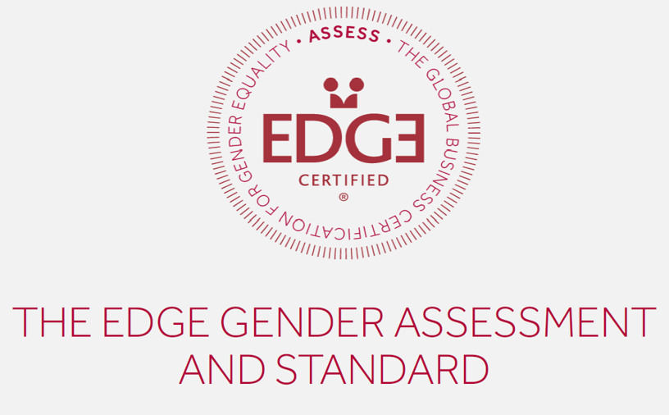
Snapshot of Gender and Age Assessments Tirana – Brasov - Prishtina

Slide 2
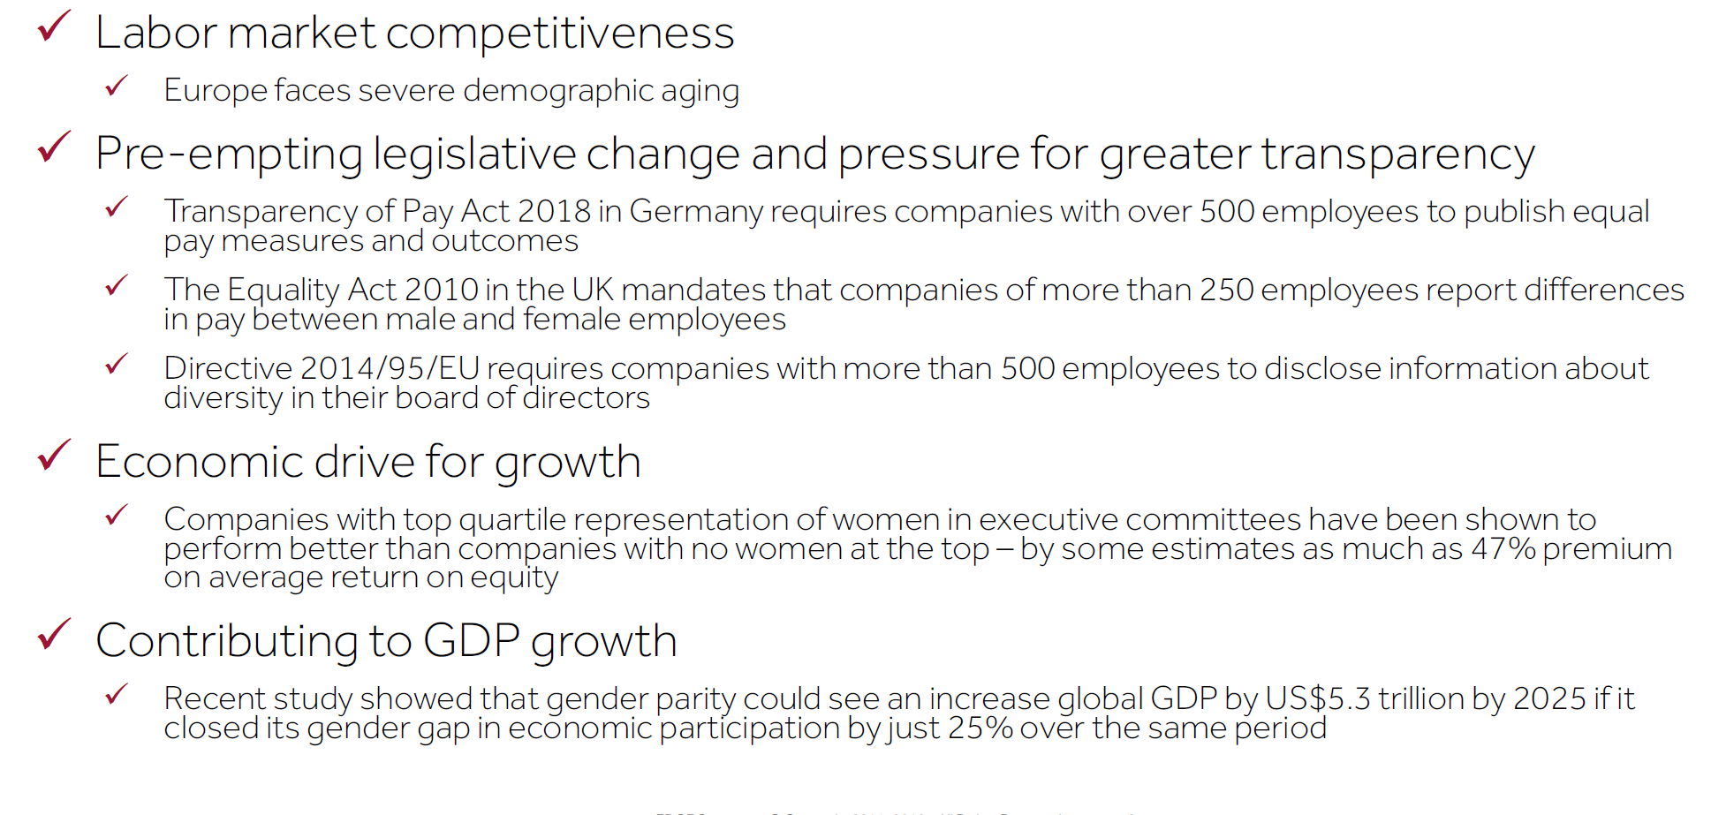
Why a diverse and gender balanced workforce?

Slide 3
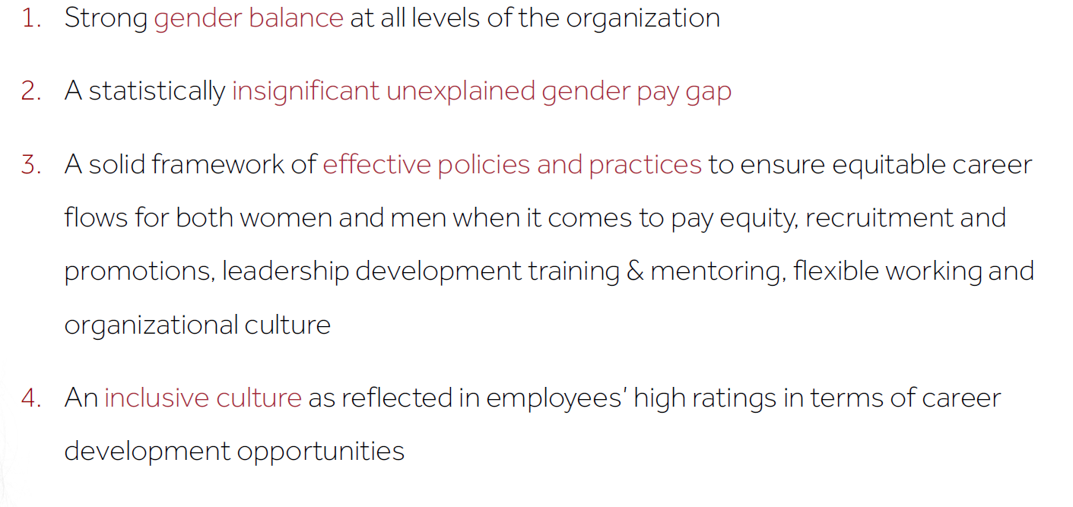
Defining success in gender equality: looking at outcomes and processes
HR statistics
Employee survey
HR policies& practices
Pay gap analysis
www.edge-cert.org

Slide 4
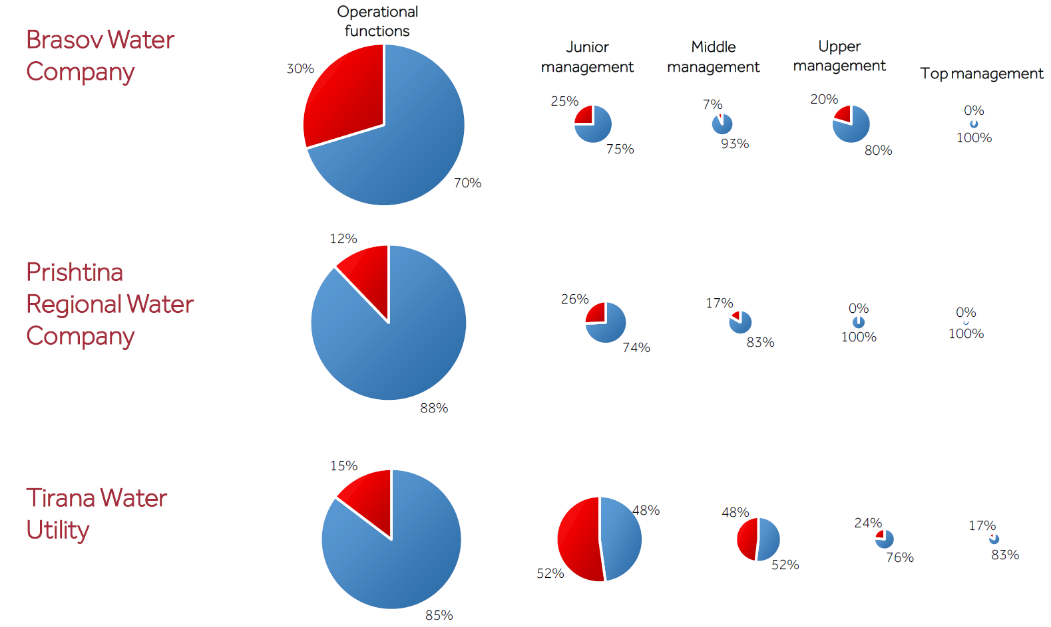
Talent pipeline: Gender Composition

Slide 5
Aging workforce requires the need to rethink renewal and transition planning process
Almost 60% of workforce is over 49 years old
Highest representation of women in 29-38 year bracket
Most exists occur at 59 and older

Slide 6
Women are more likely to be recruited at operational level and less likely to be promoted than men….
Recruitments and Exits:
Promotions
Notes:
2017 year

Slide 7
The retention or transition by female junior managers to women in top management is not (yet) happening
Board of Directors of Prishtina and Tirana had no female representation; Brasov 40 percent female representation

Slide 8
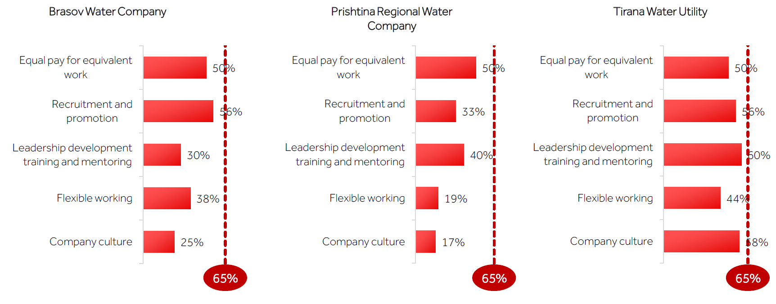
There is room to strengthen HR policies and practices and their effective implementation to promote diversity
For example for company culture, such practices could entail
Diversity and inclusion policy and communication
Top leadership commitment and targets in business plan
Budget for diversity and inclusion
Managers are accountable to improve diversity and inclusion
Sexual harassment policy in place
Notes:
Example for flexible

Slide 9
Some key findings concerning effective policies and practices
Recruitment: targets for gender composition at all levels, transition planning and gender-diverse candidate pools and interview teams
Flexible working: Informal practices, but no systematic menu of options based on needs of male and female employees in a changing society
Leadership development: limited access to formal leadership training and mentoring programs, and no systematic identification top talents
Equal pay: legislation on equal pay; but no regular assessments; communication about compensation
Culture: limited measures to promote inclusive company culture

Slide 10
I believe that men and women are given the same opportunities to be hired by this company
I believe that I am given fair opportunities to be promoted in this company:
v

Slide 11
Perceptions on equal pay may differ between men and women…. statistical assessment and communication needed
I am being paid fairly for the work I do compared to others in similar roles
Pay gap assessment for Brasov utility found that – when taking into account age, years with the company, level of responsibility, type of job, the unexplained pay gap was around 6 percent in favor of women compared to men in similar situations (inclusive of bonuses)

Slide 12
Thanks to pioneering utilities of Brasov, Tirana and Prishtina for sharing their learning and next steps

